Slide 1
7th Grade Module

Slide 2
Size Distribution by Species (histograms)

Slide 3
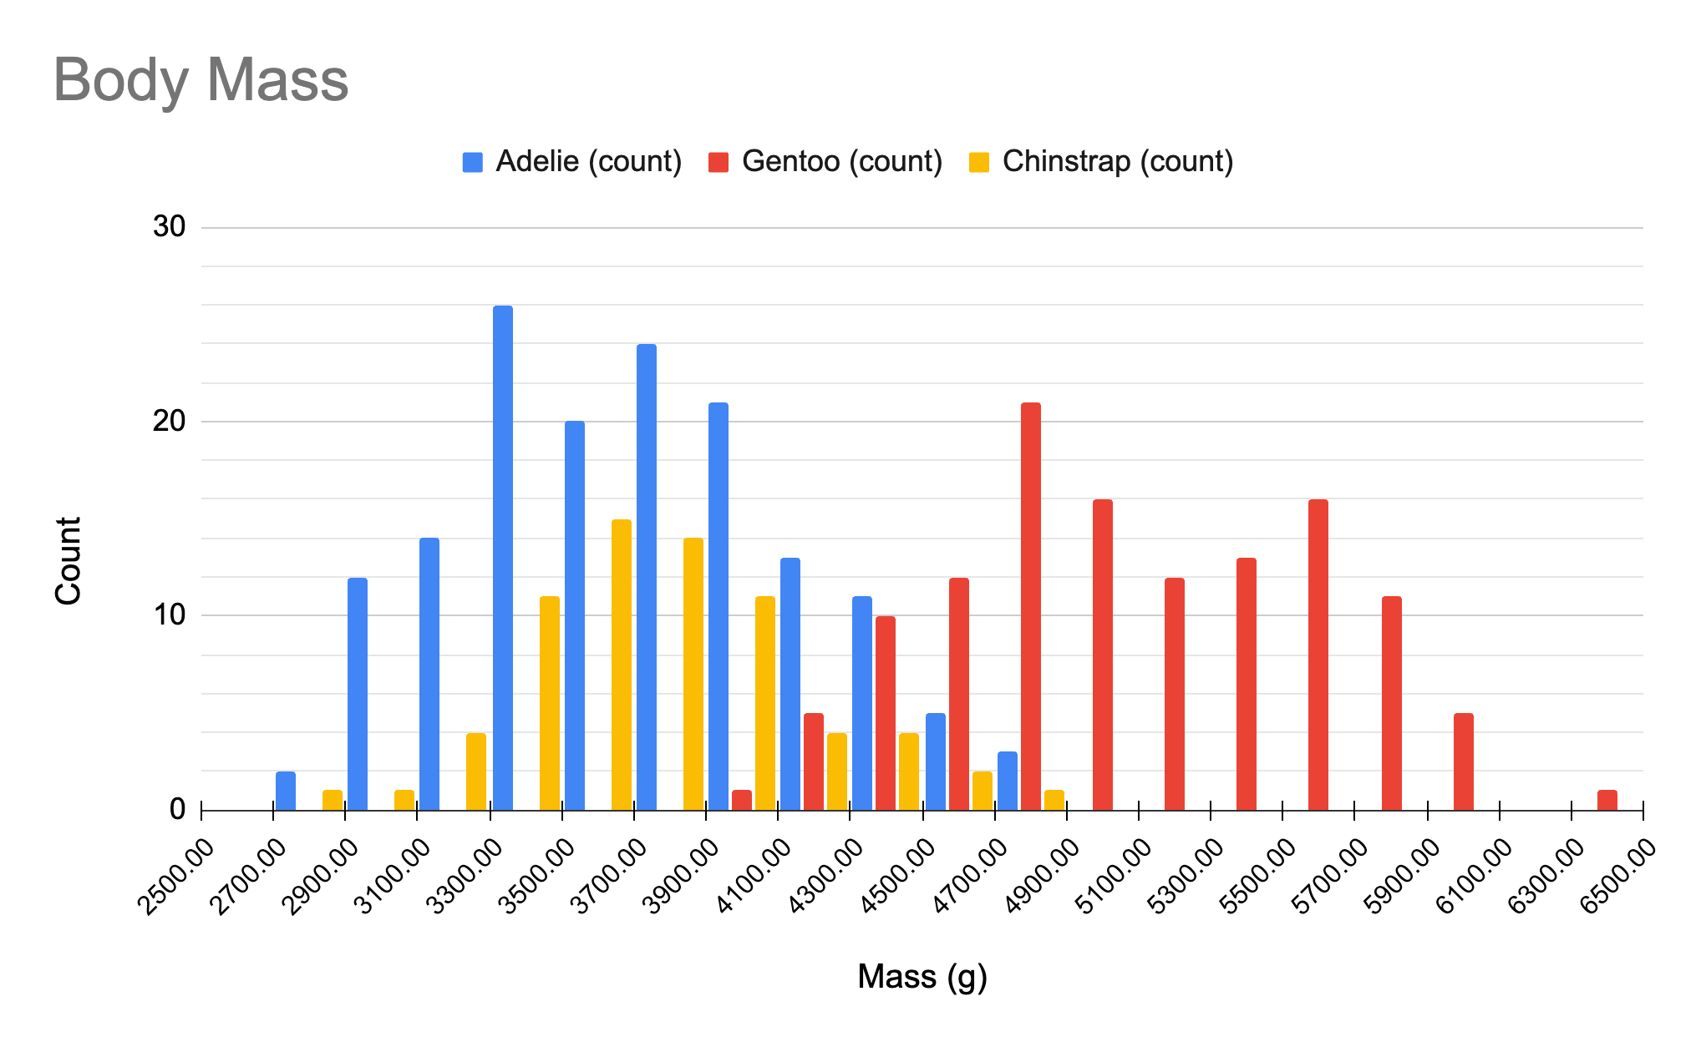
Notes:
Discuss together:
Which penguin species is the heaviest? (Gentoo)
Lightest? (Adelie)
How can we tell? (Most of the adelie penguins have masses on the left side of the axis, indicating lighter weights, most of the gentoo penguins has masses on the right side of the axis, indicating heavier weights)
About how much heavier do gentoo penguins appear to be than adelie? (around 1400 grams based on the “middle” of the adelie penguin weight appearing to be around 3600g and the “middle” of the gentoo weight being around 5000 g)
What shape does the distribution have? (mostly a “bell-shape”, more penguins with weights in the middle for each species, fewer that are very light or very heavy)

Slide 4
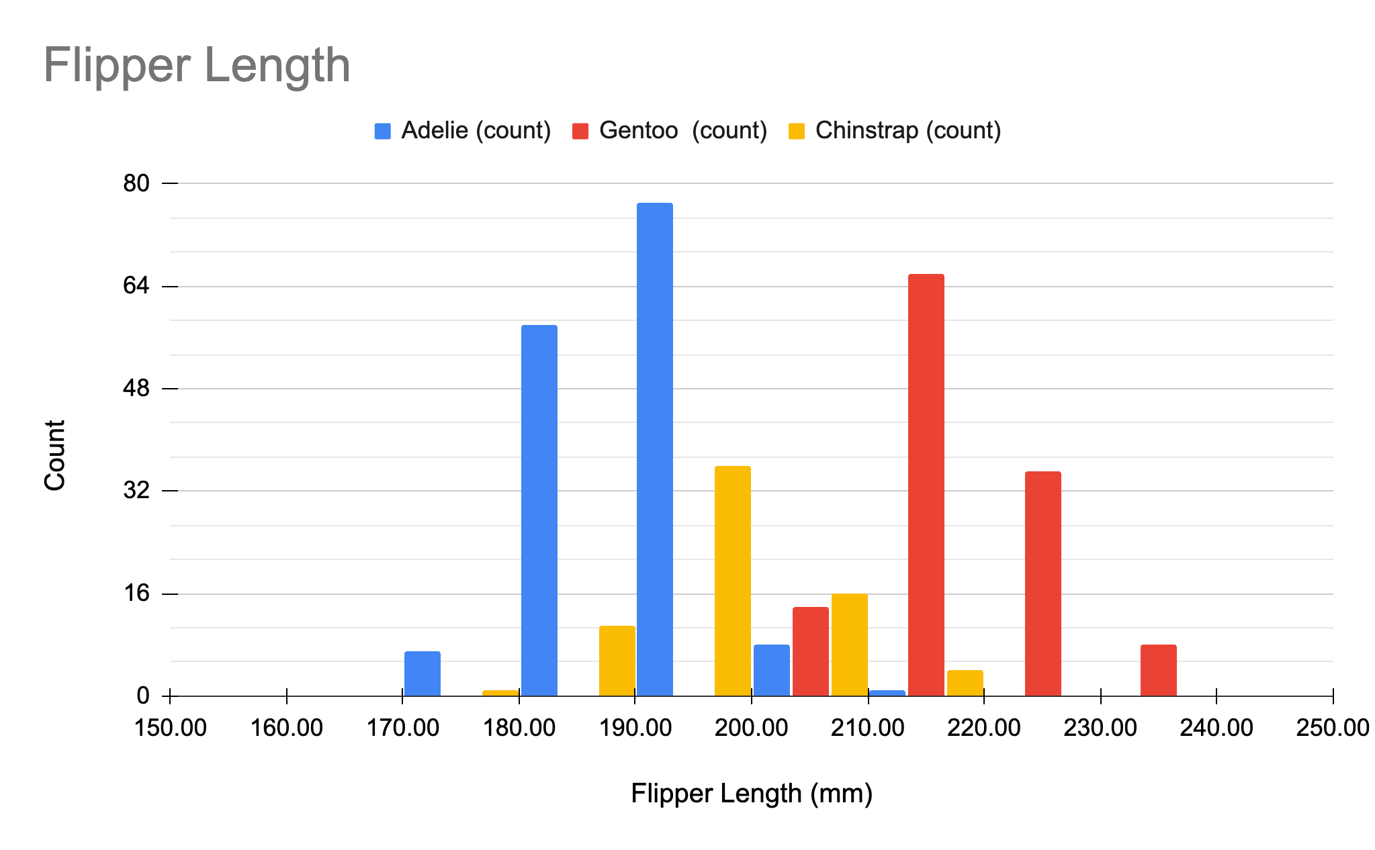
Notes:
Discuss together:
Which penguin has the longest flippers? (Gentoo)
Shortest? (Adelie)
How can we tell? (similar response to the last slide)

Slide 5
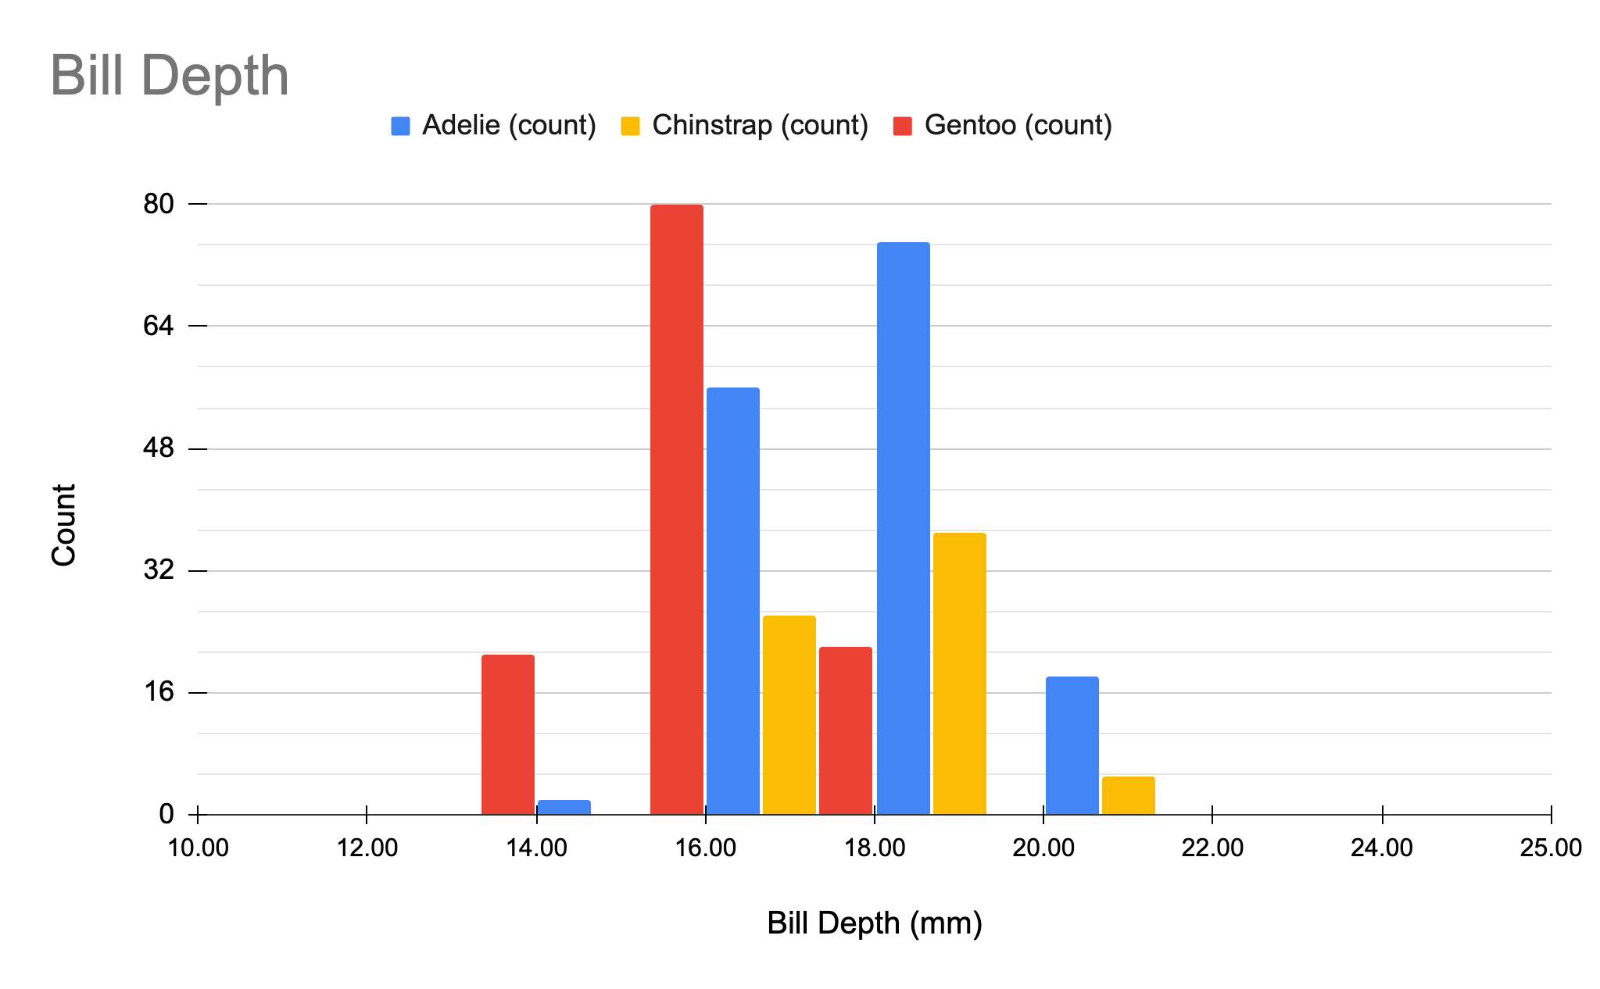
Notes:
Ask students to discuss with a classmate:
Which penguin has the deepest bill? (chinstrap and adelie appear to be fairly similar)
Shallowest? (gentoo)

Slide 6
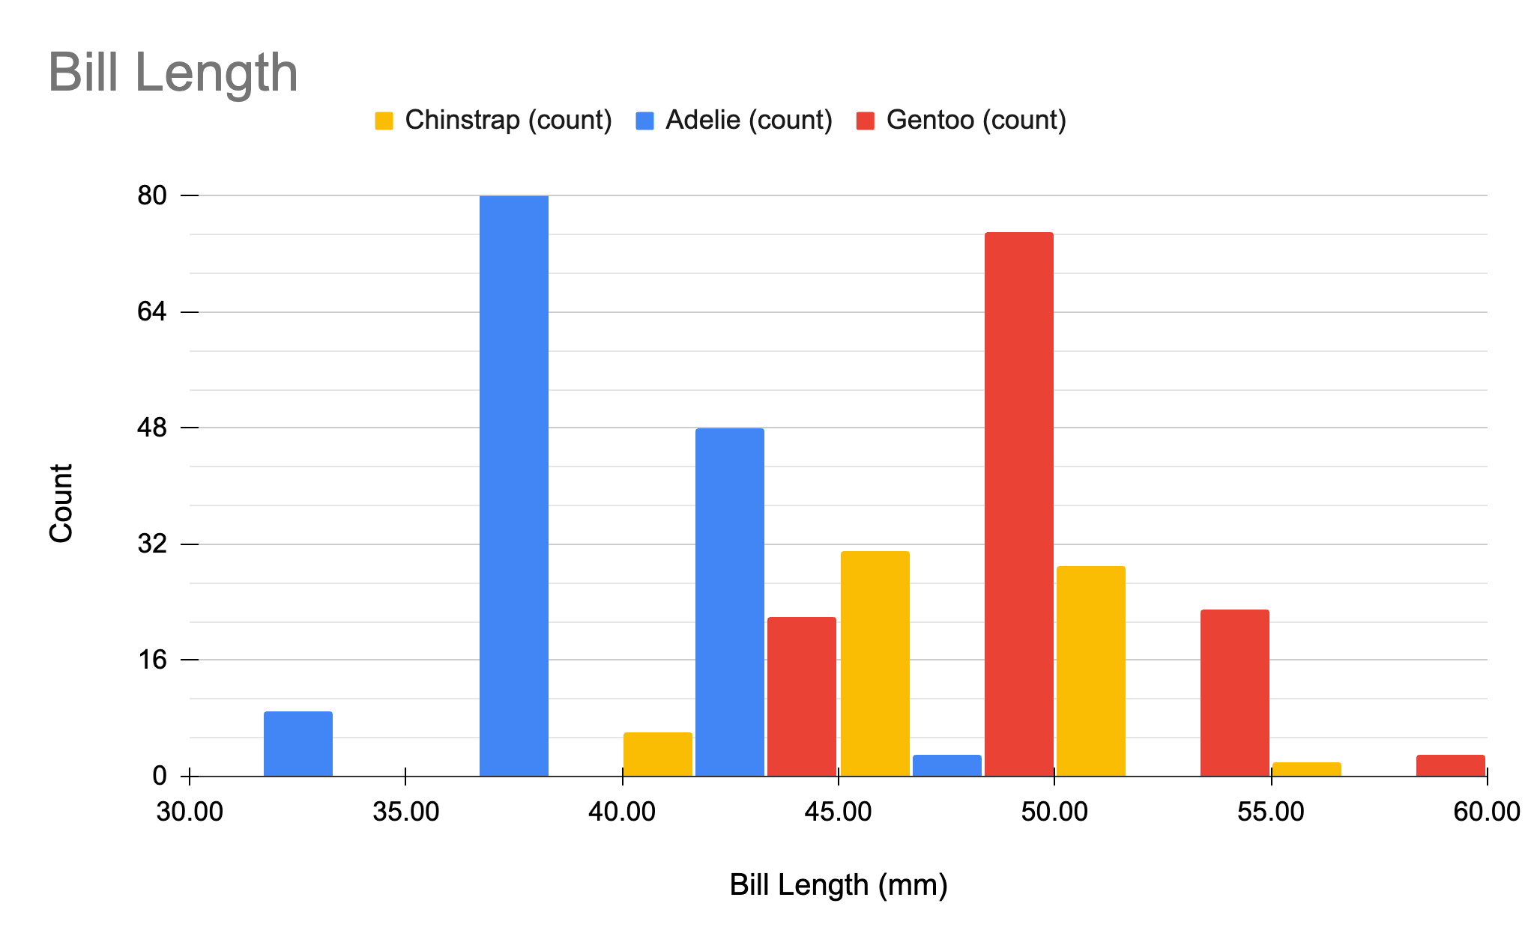
Notes:
Ask students to discuss with a classmate:
Which penguin has the longest bill? (Gentoo)
Shortest? (Adelie)
How can you tell?

Slide 7
Size Distribution by Species (box plots)

Slide 8
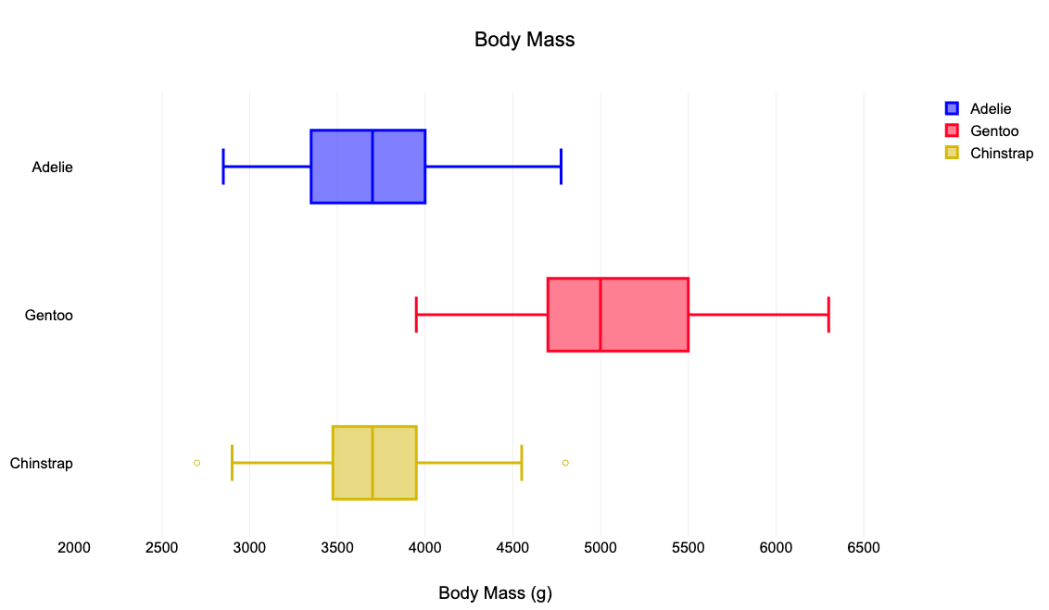
Notes:
How are the body masses similar? How are they different? Which penguin species has the most variation in mass?

Slide 9
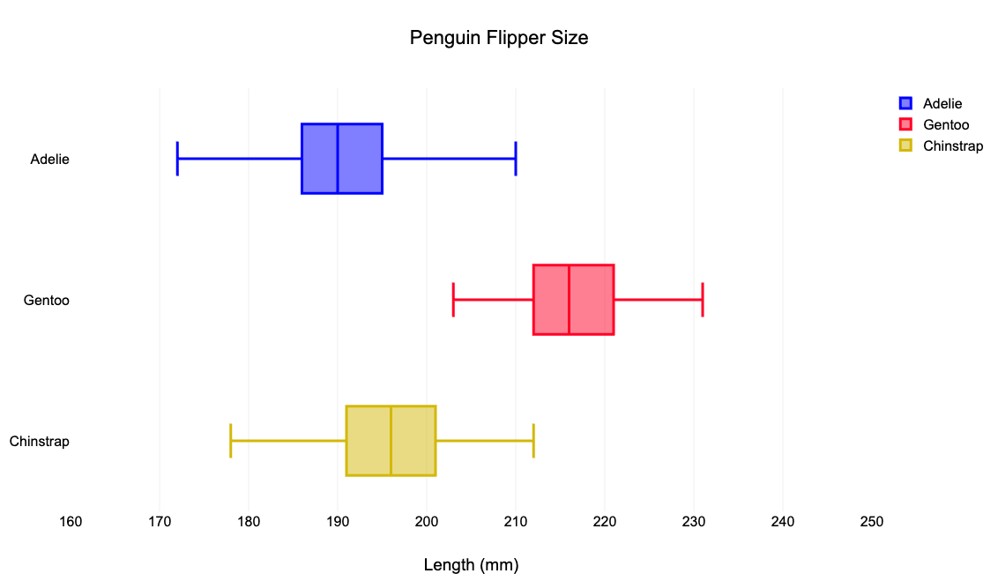
Notes:
How are the flipper sizes similar? How are they different?

Slide 10
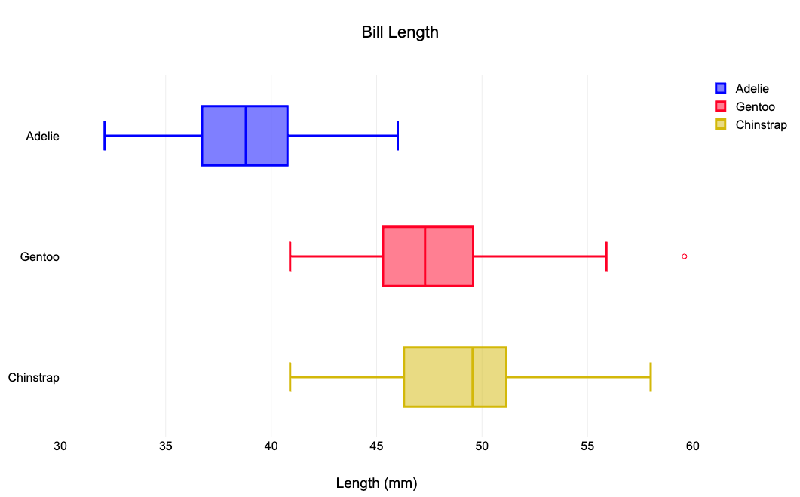

Slide 11
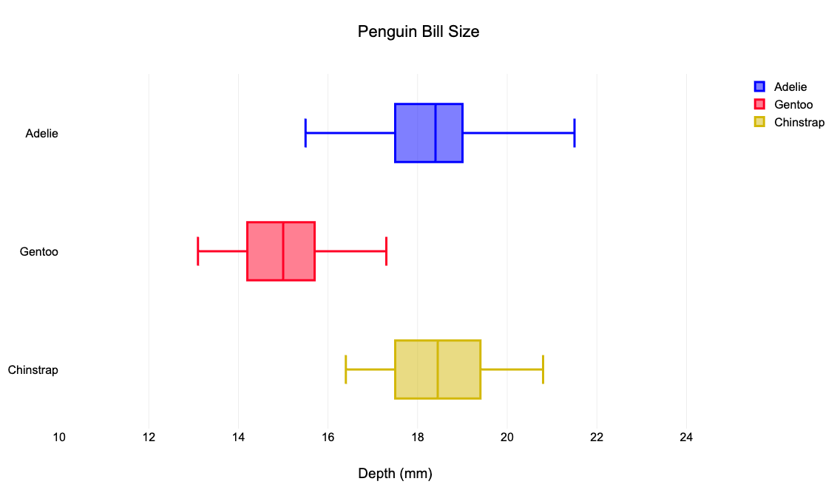

Slide 12
Mass Distribution by Sex (histograms)

Slide 13
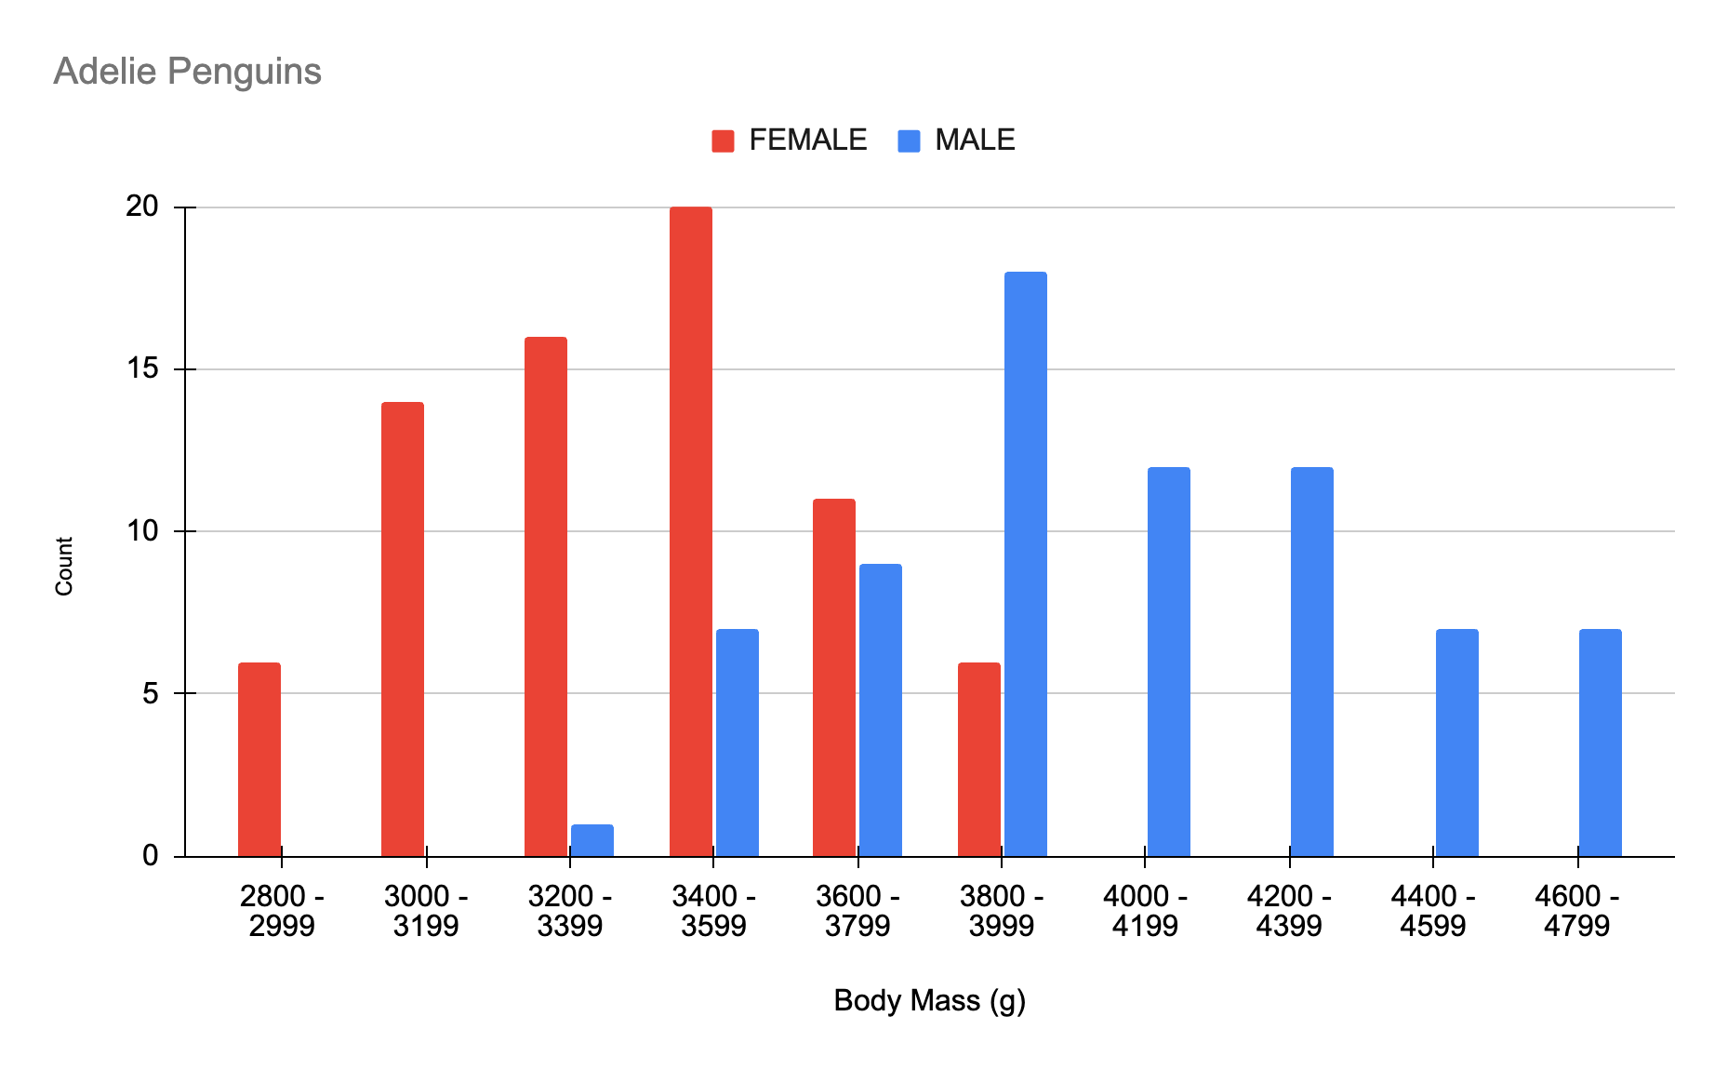
Notes:
How does the mass of female adelie penguins compare to the mass of male adelie penguins?
(female penguins are lighter)
About how much lighter (typically) are female adelie penguins than male?
(about 500-600 g)

Slide 14
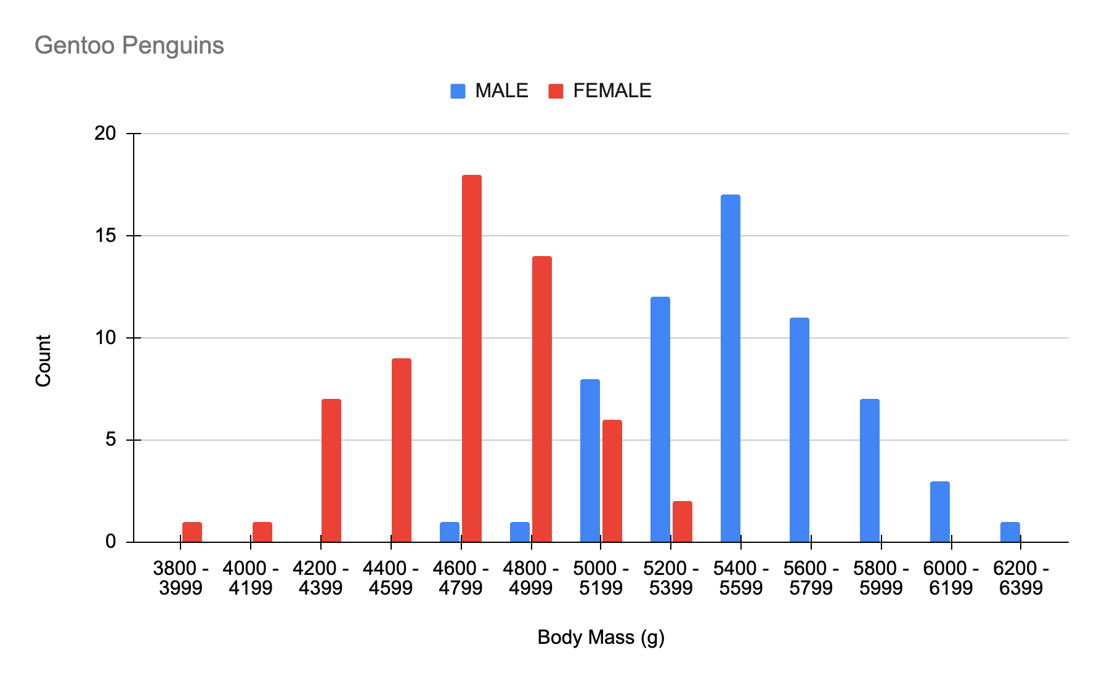
Notes:
What do you notice about the shape of the distribution for male and female penguins?
(the shape is very similar)

Slide 15
