Slide 1
8th Grade Module
Gapminder Regression

Slide 2
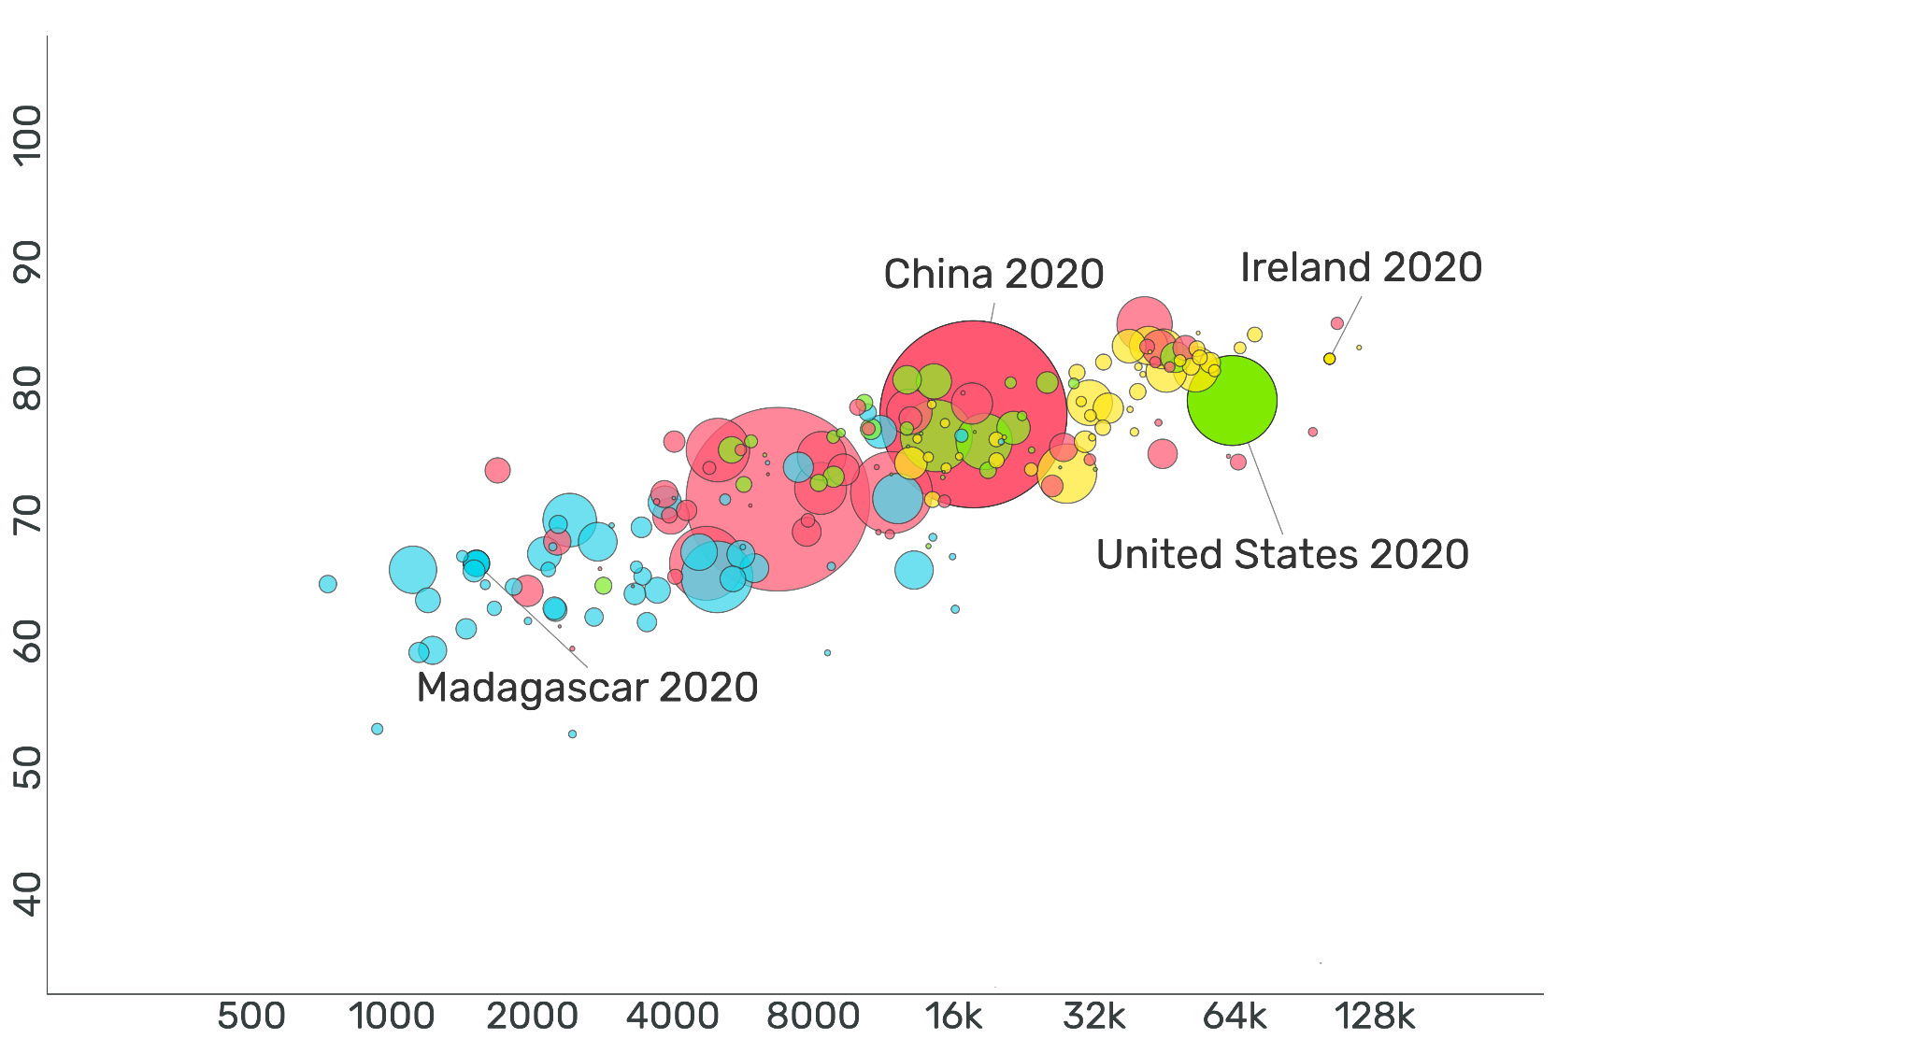
__________ vs __________ for Countries Across the World in 2020
?
?
Free teaching material from www.gapminder.org
Notes:
Tell students that we are going to make some observations about a graph. Some of the information is missing, but it will slowly be revealed.
Give students some time to look at the graph.
Then ask: What do you notice about this image? What do you wonder? There are no right or wrong answers.
Give students a minute or so to discuss with a partner, then ask some groups to share with the class.
Jot down observations on the board.
Students may notice: color, size of bubbles, where the U.S. is, etc., that the bubbles go up slowly
Students may wonder: What is the graph measuring? Why are the bubbles different sizes?
Do not answer these questions yet, but keep track of them on the board.

Slide 3
__________ vs __________ for Countries Across the World in 2020
Free teaching material from www.gapminder.org
Notes:
Ask:
What new information did we learn? (the numbers were added to the x and y axis)
What variables do you think we might be measuring on the x and y axis?
You may need to point out that the 16k represents 16,000, etc.
Jot down some proposals.

Slide 4
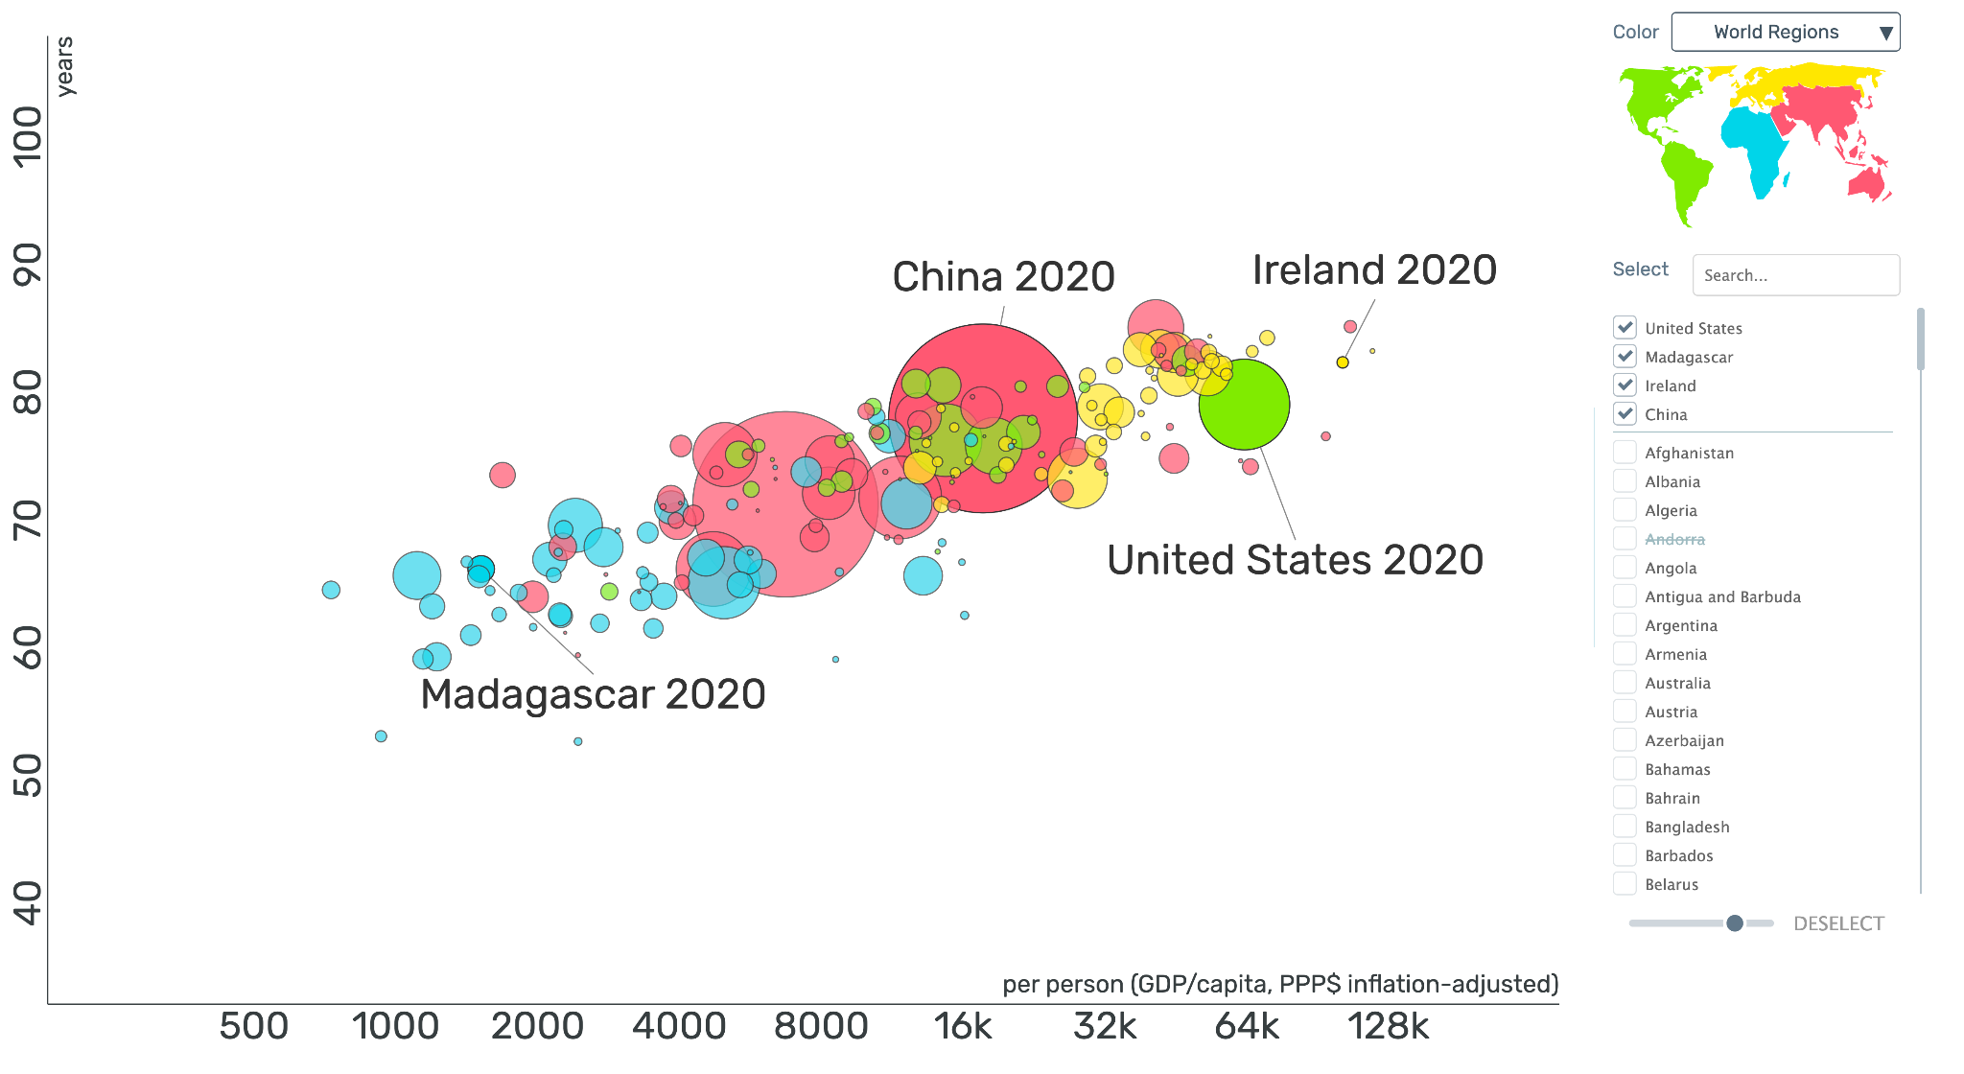
Income vs Life Expectancy for Countries Across the World in 2020
Life Expectancy
Income
Free teaching material from www.gapminder.org
Notes:
Ask: What new information did we learn?
Discuss: What is life expectancy? What is income?
Life expectancy is the estimated age to which the average person born in 2020 can expect to live. Income as measured here is the economic output of the country per person.
Ask:
Some countries are toward the left-hand side of the graph and some are on the right-hand side. What does that mean? Countries to the left have a lower income and countries to the right have a higher income
Some countries are on the lower part of the graph and others are on the upper part of the graph. What does that mean?
Countries that are the lower part of the graph have the shortest life expectancy, and countries in the upper part have longer life expectancies.
Do you see any pattern related to income and life expectancy? Describe it and discuss with a partner. As income increases, so does life expectancy.
Why do you think income and life expectancy are or aren’t related? Notice that the bubbles are in an approximately straight line and all follow approximately the same shape or pattern.
Keep track of observations on the board.

Slide 5
Income vs Life Expectancy for Countries Across the World in 2020
Life Expectancy
Income
Free teaching material from www.gapminder.org
Notes:
Ask: What new information were we given? What do the colors of the bubbles represent?
We were given the color map relating each color to a region of the world.
Ask: Do you see any patterns in the colors on the graph? Discuss what you notice with a partner.
Students may notice: Many of the low income, low life expectancy countries are blue, located in Africa. Most of the yellow (Europe and Russia) have higher incomes and higher life expectancies. The green bubbles appear to have the most variety in location and are spread throughout the graph.
Point out: Often, two variables are not enough to tell a complete data story. We’ve looked at income and life expectancy, but location is another variables as well. It is a variable that is a category, not a number. When we look at more than two variables, we are using “multivariate thinking.”

Slide 6
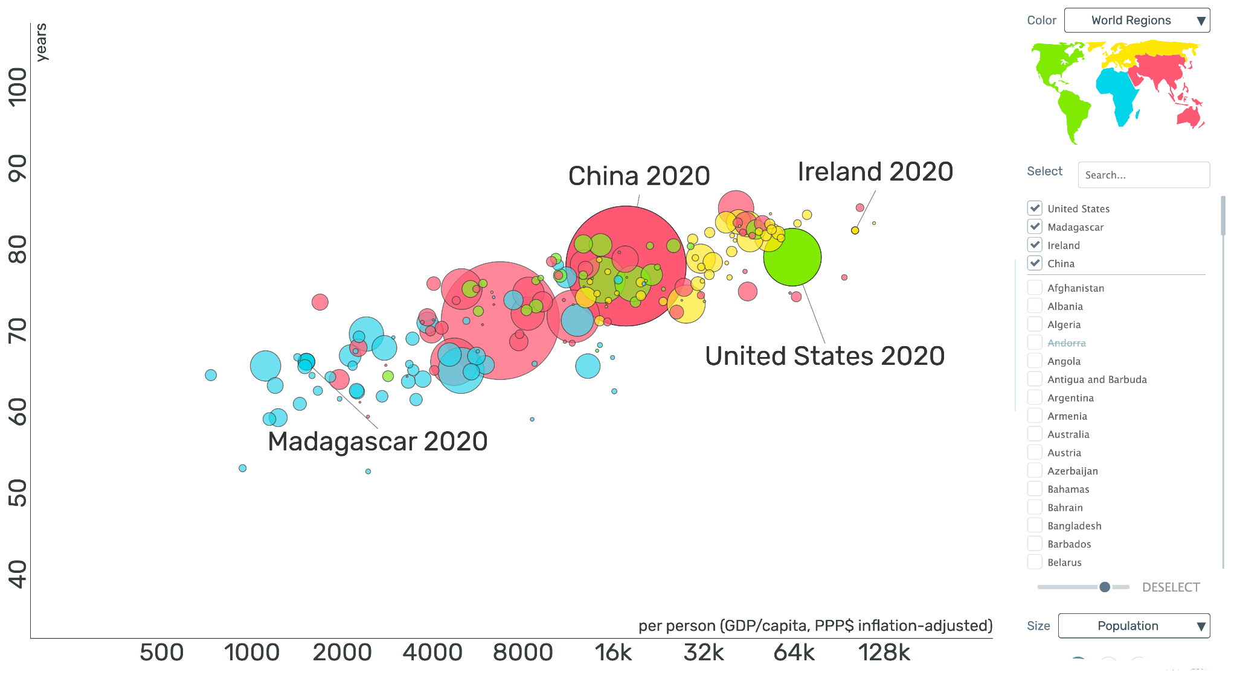
Income vs Life Expectancy for Countries Across the World in 2020
Life Expectancy
Income
Free teaching material from www.gapminder.org
Notes:
Ask: What new information were we given? What does the size of each bubble represent?
The size of each bubble represents the population of the country. Larger bubbles, like China, represent larger populations.
Ask: Do you see in patterns in the size of the bubbles? Discuss with a partner.
Students may notice that many of the low income countries have smaller bubbles and smaller populations – but some also appear at the right with the highest income and life expectancy. The countries with the largest populations are mostly in the middle of the graph.

Slide 7
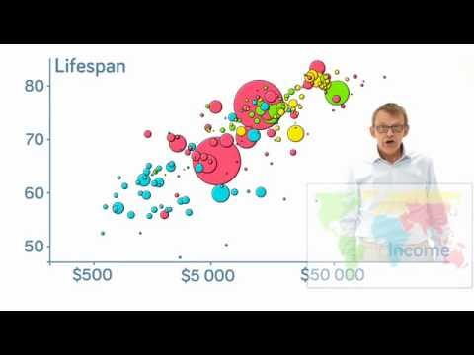
Notes:
Optional Extension for after the discussion:
Show the Hans Rosling 2-minute video.
Questions to ask students about the video:
Did he explain anything on the graph that didn’t make sense before?
Does he think there is a relationship?

Slide 8
Notes:
Show students the video showing the change in the United States life expectancy and income over time. (you can adjust the playback speed to make it go faster, if desired)
Have them discuss the general trend in life expectancy over time. What could account for the dips in life expectancy in 1863 and 1916?

Slide 9
Lab Activity
Select a country of your choice and answer the following questions:
What country did you choose?
What was its life expectancy and income in 2020?
What is one country that has a shorter life expectancy than your country?
What is one country that has a longer life expectancy than your country?
What is one country that has a lower income than your country?
What is one country that has a higher income than your country?
Click the “play” button at the bottom of the screen. Write a few sentences describing how the income and life expectancy have changed over time. Were there any dates where something out of the ordinary happened?
Then use the data for all countries to make some predictions.
How long would you expect to live if your home country’s average income was $150,000? How did you make this prediction?
What average income would you expect if the life expectancy of the country is 60 years? How did you come up with this number.
Notes:
Now have students pull up the visualization and answer the questions.
Discuss their predictions and have the class compare answers. It is likely that there will be a variety of responses. Point this out, and discuss the uncertainty and variety in the predictions. Tell students that they will soon be learning how to answer these questions in the most accurate way without just guessing.

