Slide 1
8th Grade Module
Scatterplots – Types of Association

Slide 2
Scatter plots & Types of Association
Teacher Notes
This presentation includes several example scatter plots that could be used to discuss types of association (positive, negative, no association).
To simplify the scatterplot, the bubbles no longer represent the population size and countries are no longer colored by region.
If you don’t see any that appeal to your students, you can create your own using Gapminder.
You can make the bubbles all the same color by clicking the options gear, opening the color menu, and choosing single color.
If you would like to adjust the bubble size or make them all the same size, open the size menu and drag the adjuster.

Slide 3
Scatter plots & Types of Association
Teacher Notes Continued
Currently the slides are grouped by type of association. You will want to mix them up before displaying and discussing them with your students.
After discussing a couple of scatterplots, you may want to consider asking students to predict what type of association the variables will have before revealing the graph. This could easily be accomplished by placing a rectangle over the plot and then deleting it after having students make their prediction.
Depending on your goal and level of students you may also want to consider discussing the strength of association between the variables. Some have a strong association and some are weaker.

Slide 4
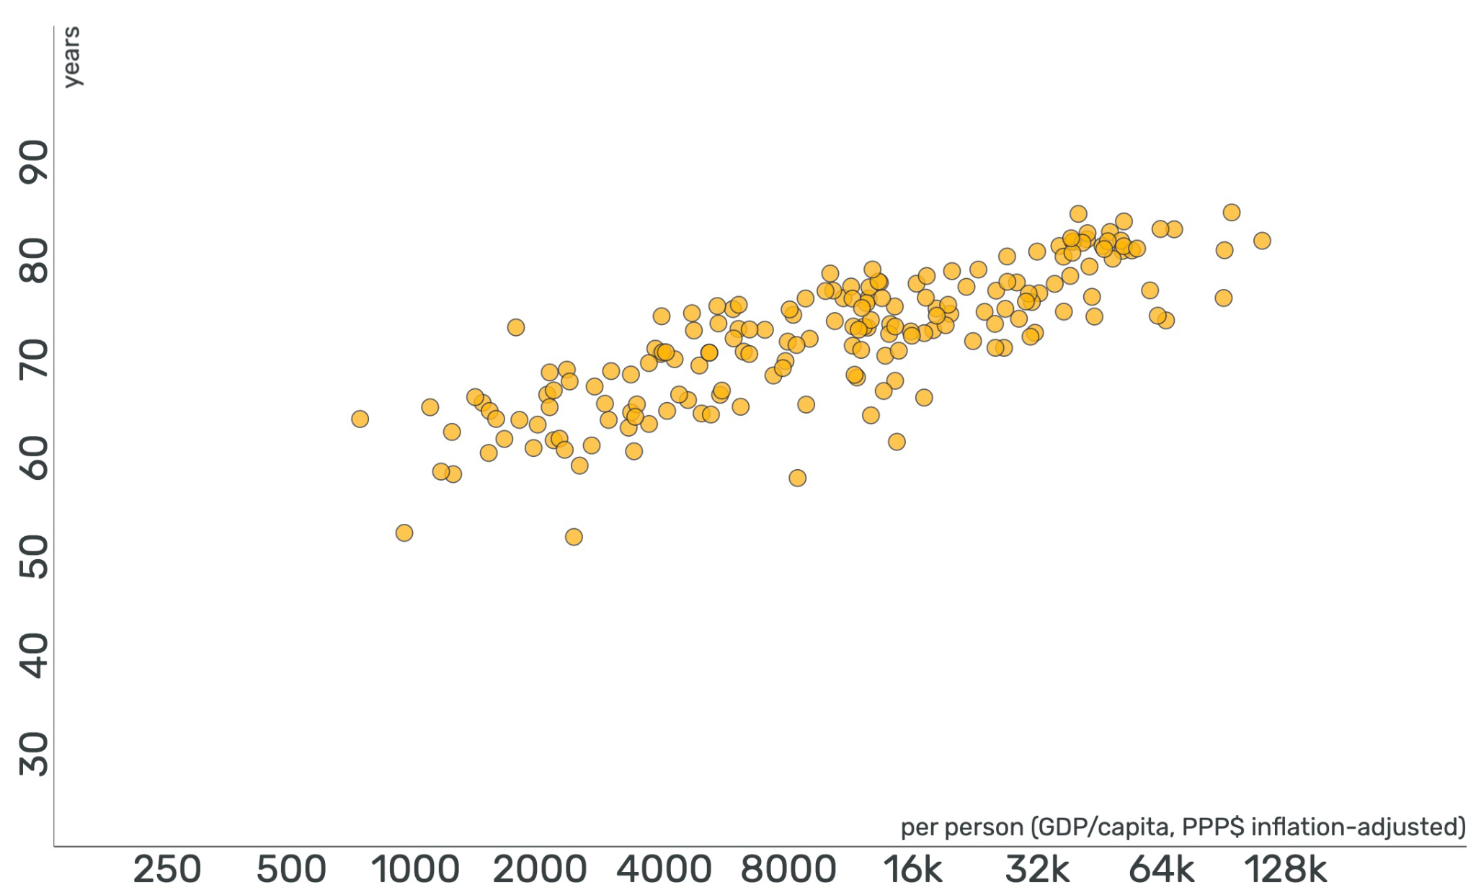
Life Expectancy
Income
Free teaching material from www.gapminder.org
Notes:
Ask students to describe what type of association the data has.
Students should notice that there is a positive correlation between income and life expectancy.
Ask students why this might be the case. Possible answers include more money for healthcare, better sanitation and living conditions, etc.
Data from 2020

Slide 5
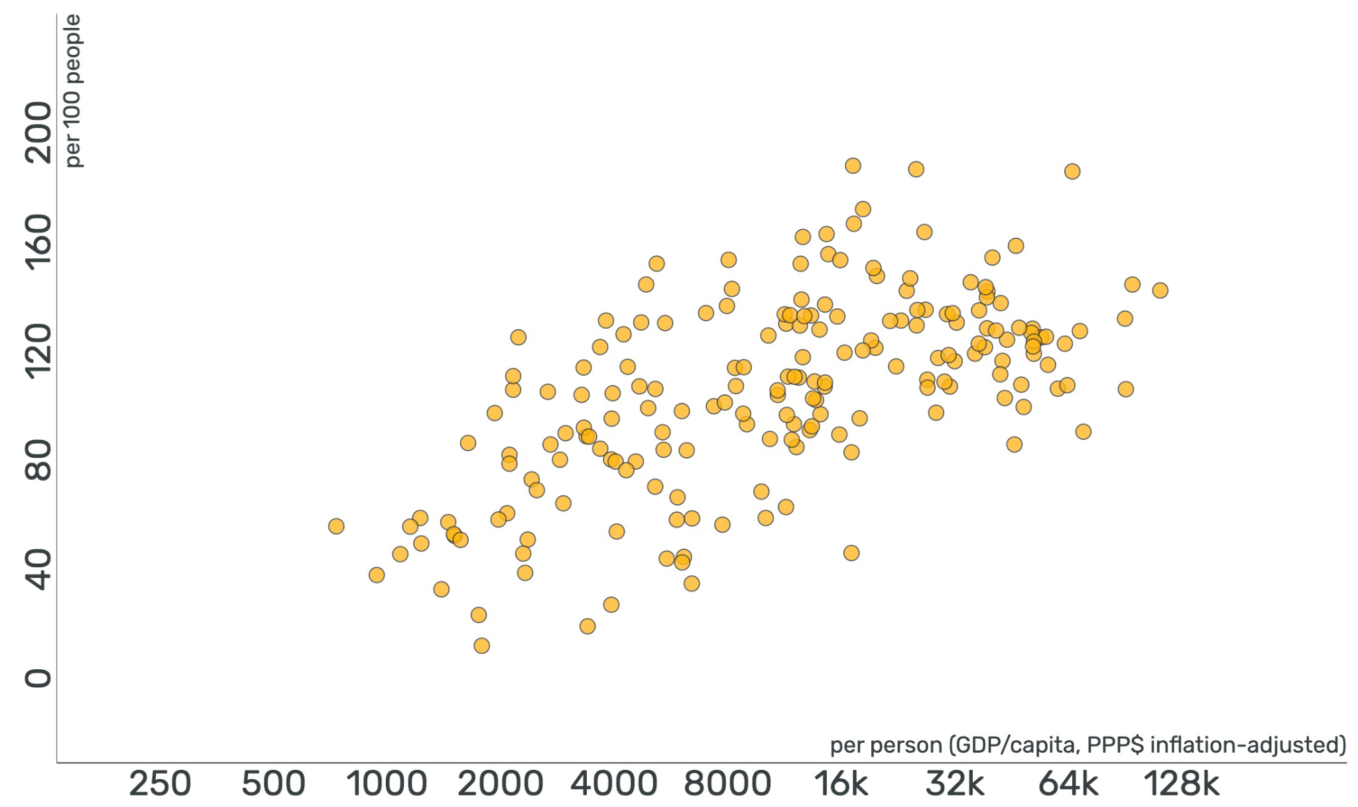
Number of Cell Phones
Income
Free teaching material from www.gapminder.org
Notes:
Ask students to describe what type of association the data has.
Students should notice that there is a positive correlation between income and cell phones (per 100 people).
You may want to point out that is a slightly weaker association than the life expectancy data.
Data from 2018

Slide 6
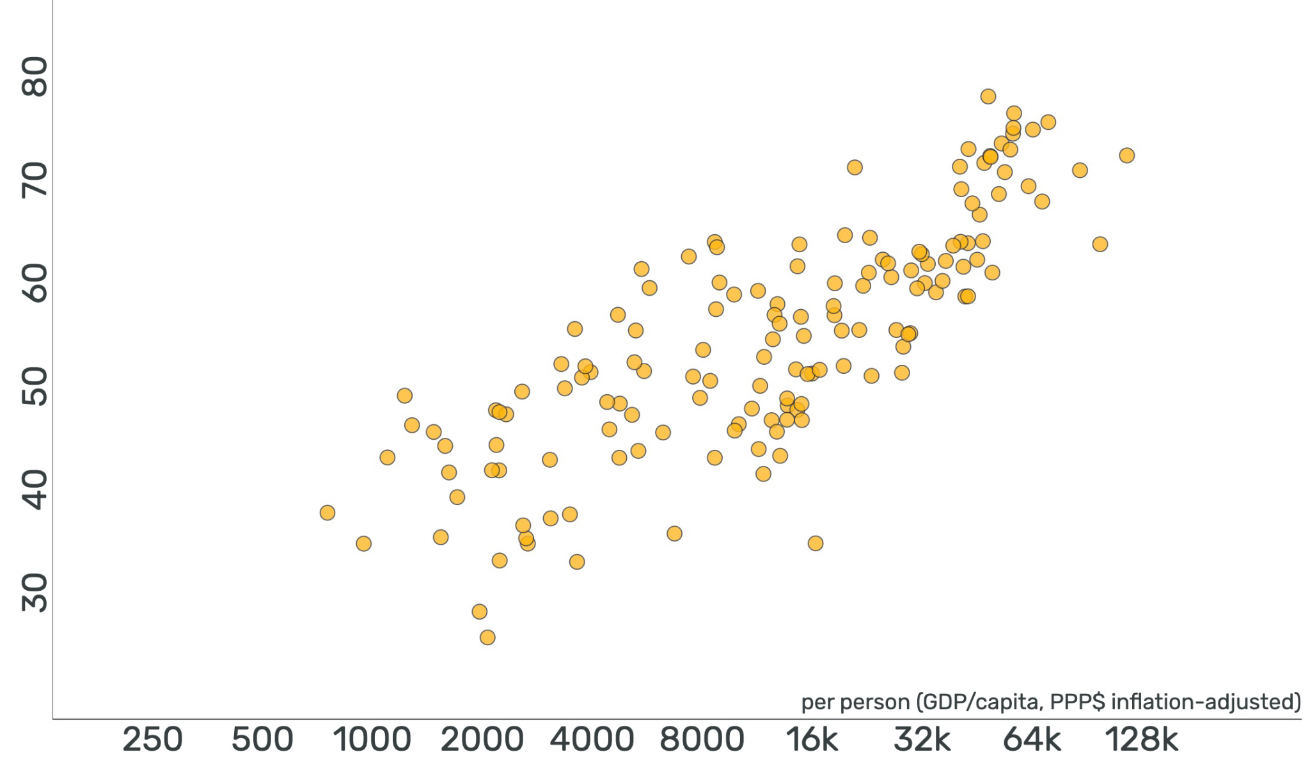
Happiness Score
Income
Free teaching material from www.gapminder.org
Notes:
The “happiness score” is defined by the national average response to the statement: “Please imagine a ladder with steps numbered from 0 at the bottom to 10 at the top. The top of the ladder represents the best possible life for you and the bottom represents the worst possible life for you. On which step of the ladder would you say you personally feel you stand at this time?” Gapminder has converted responses to a 0 to 100 scale to easily communicate it as percentage.
Ask students to describe what type of association the data has.
Students should notice that there is a positive correlation between income and happiness score.
Ask students why this might be the case.
Data from 2018

Slide 7
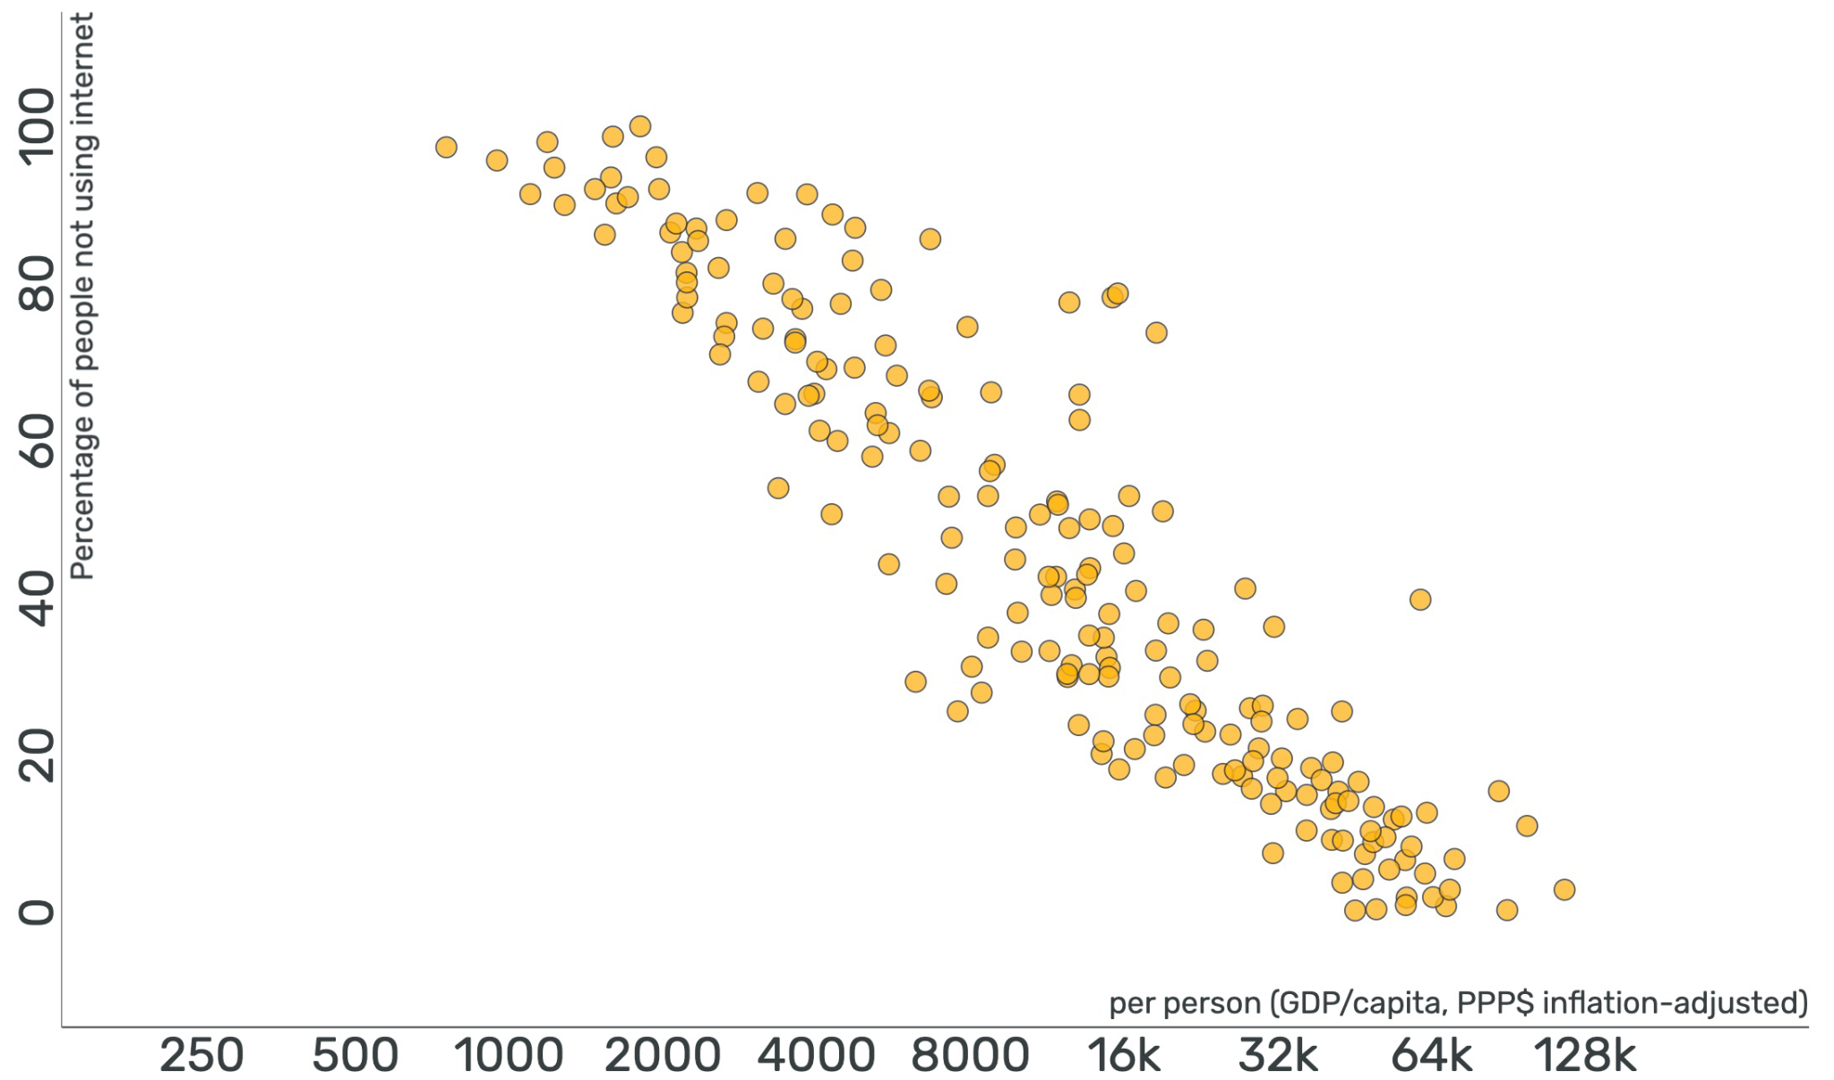
Percentage of people not using the internet
Income
Free teaching material from www.gapminder.org
Notes:
Ask students to describe what type of association the data has.
Students should notice that there is a negative correlation between income and percentage of people not using internet.
Ask students why this might be the case. Possible answers include that as income rises, more internet access is available.
Data from 2018

Slide 8
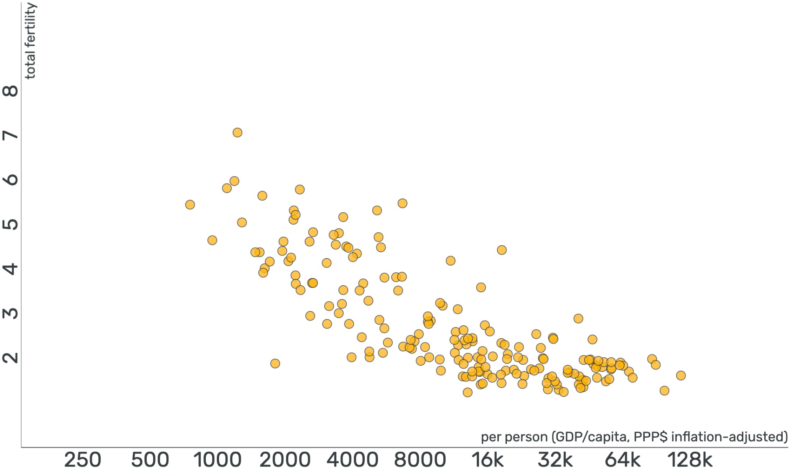
Babies born per woman
Income
Free teaching material from www.gapminder.org
Notes:
Ask students to describe what type of association the data has.
Students should notice that there is a negative correlation between income and fertility.
Data from 2018

Slide 9
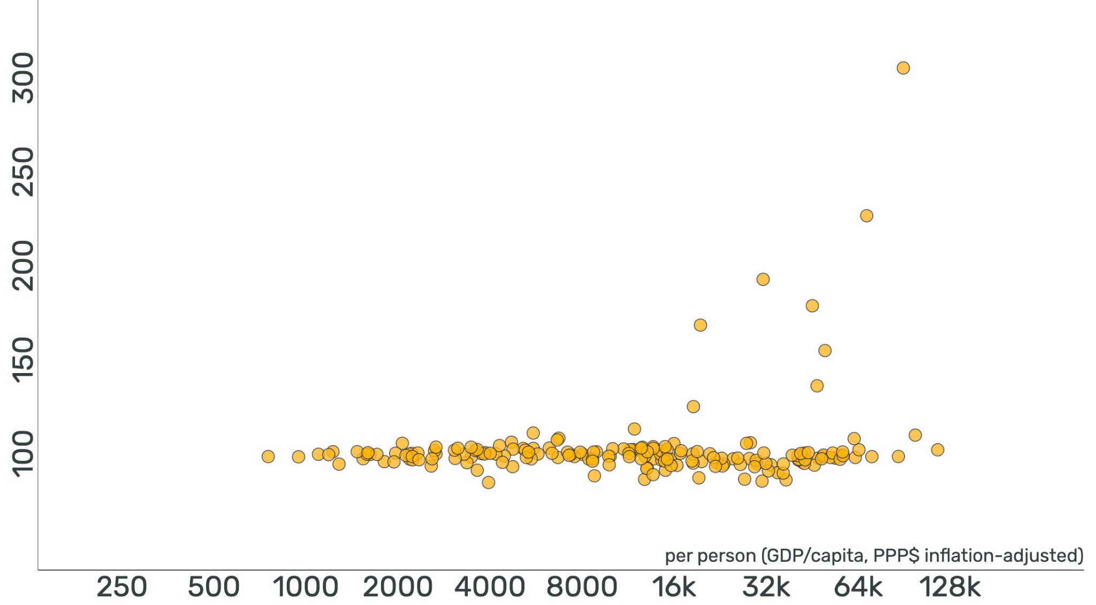
Ratio of Male:Female
Income
Free teaching material from www.gapminder.org
Notes:
Ask students to describe what type of association the data has.
Students should notice that there is no association between income and ratio of male:female in the population. No matter the income, it is approximately a 1:1 ratio of males to females.
Data from 2020

Slide 10
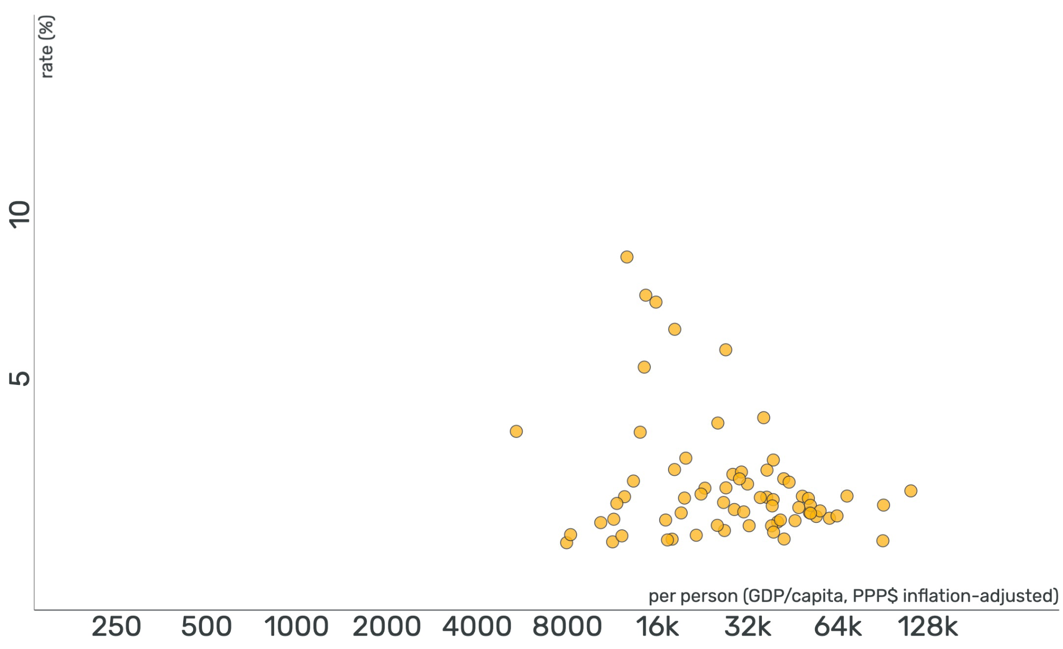
Long Term Unemployment
Income
Free teaching material from www.gapminder.org
Notes:
Ask students to describe what type of association the data has.
Students should notice that there is no association between income and long-term unemployment rate.
Data from 2019

